Slide 1
Access Control Lists John Mowry
Notes:
Cisco Networking Academy program
Routing & Switching
Chapter 9: Access Control Lists

Slide 2
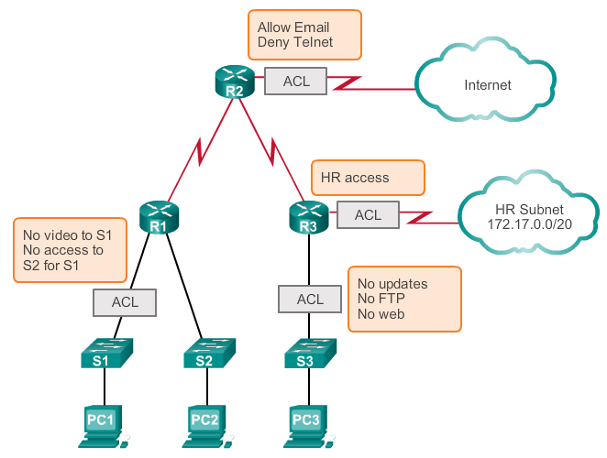
Purpose of ACLs What is an ACL?
Notes:
9.1.1.1 What is an ACL?

Slide 3
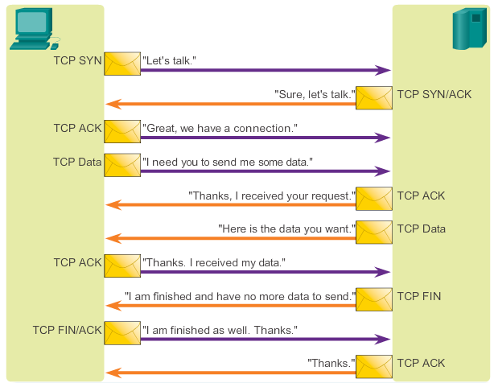
Purpose of ACLs A TCP Conversation
Notes:
9.1.1.2 A TCP Conversation

Slide 4
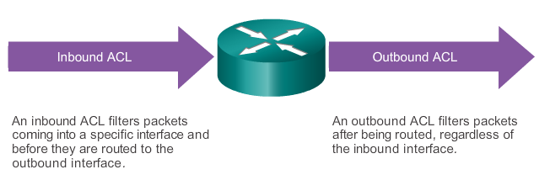
Purpose of ACLs ACL Operation
The last statement of an ACL is always an implicit deny. This statement is automatically inserted at the end of each ACL even though it is not physically present. The implicit deny blocks all traffic. Because of this implicit deny, an ACL that does not have at least one permit statement will block all traffic.
Notes:
9.1.1.5 ACL Operation

Slide 5
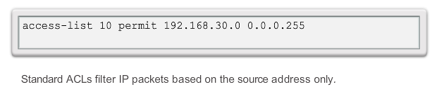
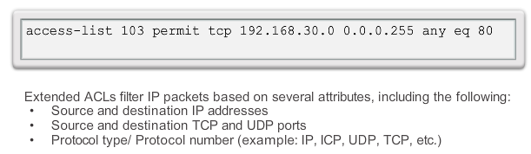
Standard versus Extended IPv4 ACLs Types of Cisco IPv4 ACLs
Standard ACLs
Extended ACLs
Notes:
9.1.2.1 Types of Cisco IPv4 ACLs

Slide 6
Wildcard Masks in ACLs Introducing ACL Wildcard Masking
Wildcard masks and subnet masks differ in the way they match binary 1s and 0s. Wildcard masks use the following rules to match binary 1s and 0s:
Wildcard mask bit 0 - Match the corresponding bit value in the address.
Wildcard mask bit 1 - Ignore the corresponding bit value in the address.
Notes:
9.1.3.1 Introducing ACL Wildcard Masking

Slide 7
Wildcard Masks in ACLs Wildcard Mask Examples: Match Ranges
Range to restrict:
172.16.0.0 – 172.31.255.255
Base IP Address:
172.16.0.0
Wildcard Mask:
0.15.255.255
Notes:
9.1.3.2 Wildcard Mask Examples (cont.)

Slide 8
Wildcard Masks in ACLs Wildcard Mask Example: Match Range
172.16.0.0
0.15.255.255
10101100 . 00010000 . 00000000 . 00000000
00000000 .00001111 . 11111111 . 11111111
Keep:
10101100 . 0001xxxx . xxxxxxxx . xxxxxxxx
Minimum:
10101100 . 00010000 . 00000000 . 00000000
Maximum:
10101100 . 00011111 . 11111111 . 11111111
Notes:
9.1.3.2 Wildcard Mask Examples (cont.)

Slide 9
Wildcard Masks in ACLs Wildcard Mask Challenge:
Question: What IP addresses does this combination isolate?
Base IP Address:
192.168.20.37
Wildcard Mask:
0.0.0.254
Notes:
9.1.3.2 Wildcard Mask Examples (cont.)

Slide 10
Wildcard Masks in ACLs Wildcard Mask Challenge:
192.168.20.37
0.0.0.254
11000000 . 10101000 . 00010100 . 00100101
00000000 .00000000 . 00000000 . 11111110
Keep:
11000000 . 10101000 . 00010100 . xxxxxxx1
Notes:
9.1.3.2 Wildcard Mask Examples (cont.)

Slide 11
Wildcard Masks in ACLs Wildcard Mask Challenge: Answer!
11000000 . 10101000 . 00010100 . xxxxxxx1
Isolates all the ODD numbers in the
192.168.20.X
Subnet!
Notes:
9.1.3.2 Wildcard Mask Examples (cont.)

Slide 12
Wildcard Masks in ACLs Wildcard Mask Keywords
Wildcard mask of:
0.0.0.0
Keeps all bits Keyword is: Host
255.255.255.255
Eliminates all bits Keyword is : ANY
Notes:
9.1.3.4 Wildcard Mask Keywords

Slide 13
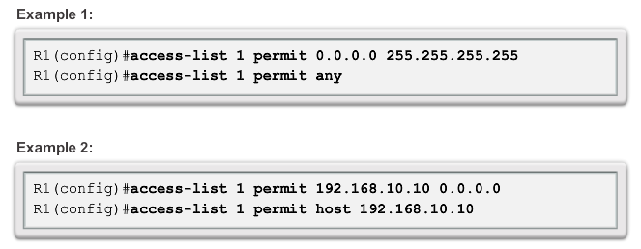
Wildcard Masks in ACLs Examples Wildcard Mask Keywords
Notes:
9.1.3.5 Examples Wildcard Mask Keywords

Slide 14
Guidelines for ACL creation General Guidelines for Creating ACLs (cont.)
The Three Ps
One ACL per protocol - To control traffic flow on an interface, an ACL must be defined for each protocol enabled on the interface.
One ACL per direction - ACLs control traffic in one direction at a time on an interface. Two separate ACLs must be created to control inbound and outbound traffic.
One ACL per interface - ACLs control traffic for an interface, for example, GigabitEthernet 0/0.
Notes:
9.1.4.1 General Guidelines for Creating ACLs (cont.)

Slide 15
Guidelines for ACL Placement Where to Place ACLs
Every ACL should be placed where it has the greatest impact on efficiency. The basic rules are:
Extended ACLs - Locate extended ACLs as close as possible to the source of the traffic to be filtered.
Standard ACLs - Because standard ACLs do not specify destination addresses, place them as close to the destination as possible.
Divide the S’s
Notes:
9.1.5.1 Where to Place ACLs

Slide 16
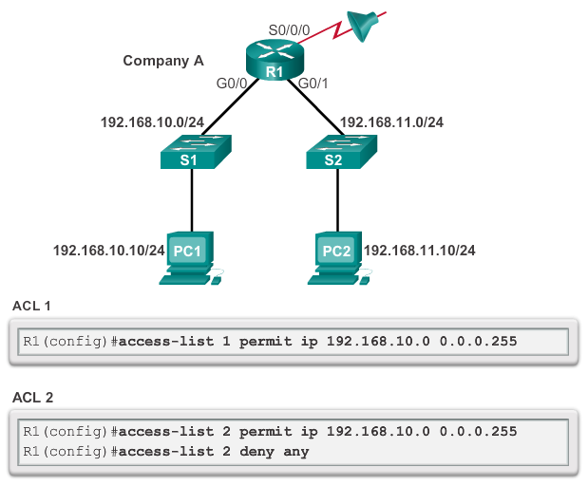
Configure Standard IPv4 ACLs Entering Criteria Statements
Notes:
9.2.1.1 Entering Criteria Statements

Slide 17
Configure Standard IPv4 ACLs Internal Logic
Rule 1
You can not deny something you have all ready permitted
Rule 2
You can not permit something you have all ready denied
Rule 3
If nothing is permitted nothing will pass
Rule 4
The best ACL in the world does nothing if it is not applied
Notes:
9.2.1.4 Internal Logic

Slide 18
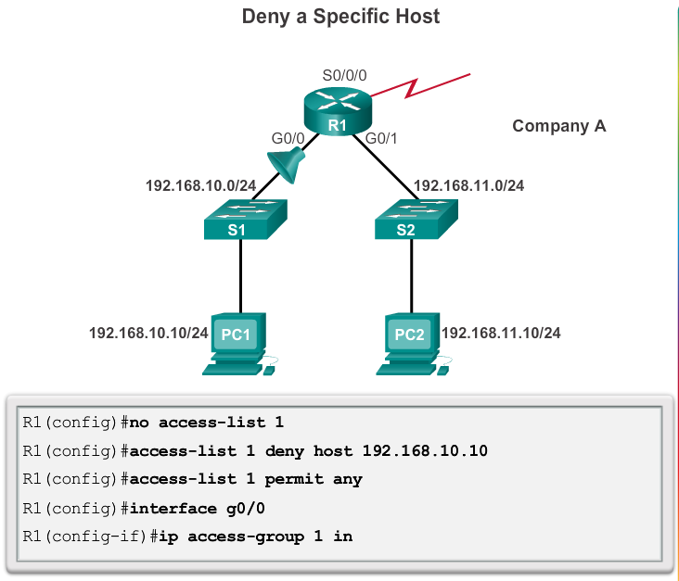
Configure Standard IPv4 ACLs Applying Standard ACLs to Interfaces (Cont.)
Notes:
9.2.1.6 Applying Standard ACLs to Interfaces (Cont.)

Slide 19
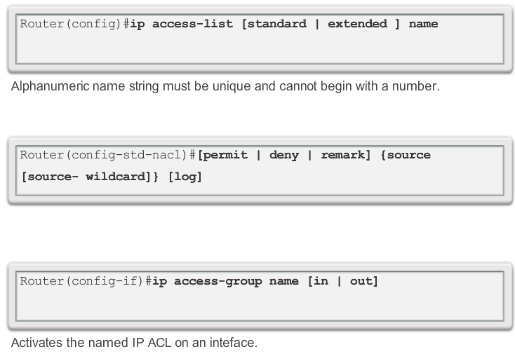
Configure Standard IPv4 ACLs Creating Named Standard ACLs
Notes:
9.2.1.7 Creating Named Standard ACLs

Slide 20
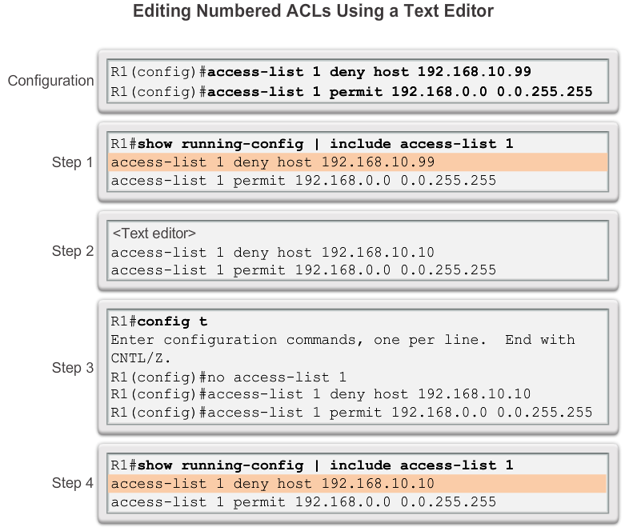
Modify IPv4 ACLs Editing Standard Numbered ACLs
Notes:
9.2.2.1 Editing Standard Numbered ACLs

Slide 21
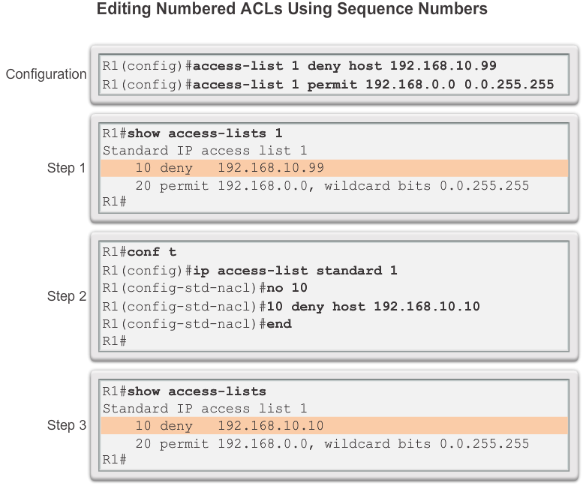
Modify IPv4 ACLs Editing Standard Numbered ACLs (cont.)
Notes:
9.2.2.2 Editing Standard Numbered ACLs (Cont.)

Slide 22
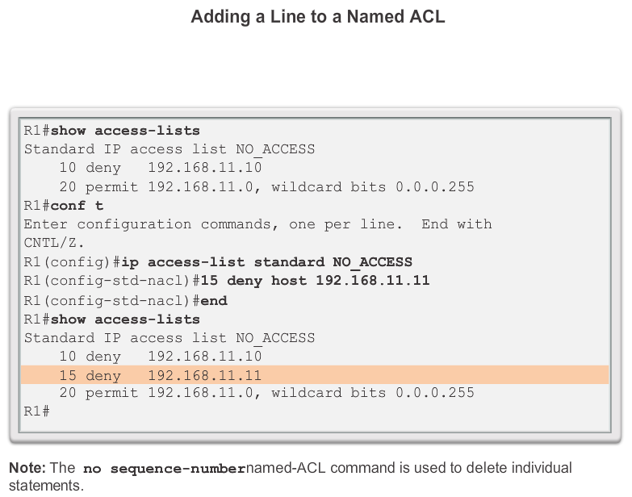
Modify IPv4 ACLs Editing Standard Named ACLs
Notes:
9.2.2.3 Editing Standard Named ACLs

Slide 23
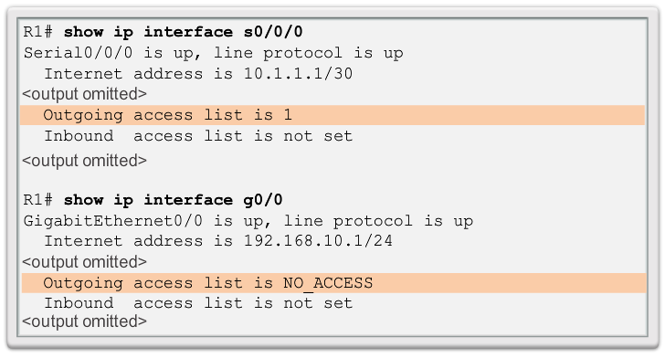
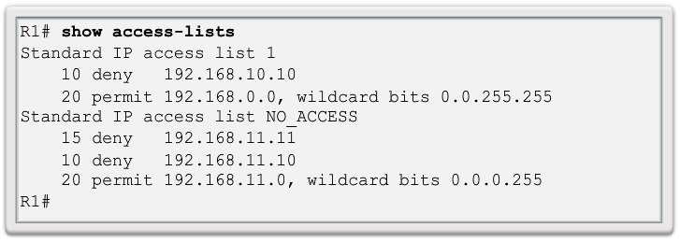
Modify IPv4 ACLs Verifying ACLs
Notes:
9.2.2.4 Verifying ACLs

Slide 24
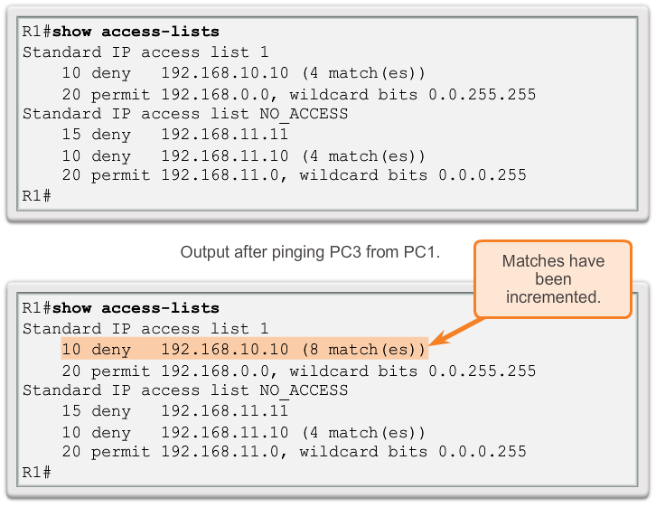
Modify IPv4 ACLs ACL Statistics
Notes:
9.2.2.5 ACL Statistics

Slide 25
Modify IPv4 ACLs ACL Statistics
ip access-list TRAFFIC_USE
10 permit tcp any any eq 80
20 permit tcp any any eq 20
30 permit tcp any any eq 21
40 permit tcp any any eq 23
50 permit udp any any eq 67
60 permit udp any any eq 68
70 permit ip any any
Notes:
9.2.2.5 ACL Statistics

Slide 26
Securing VTY ports with a Standard IPv4 ACL Configuring a Standard ACL to Secure a VTY Port
Filtering Telnet or SSH traffic is typically considered an extended IP ACL function because it filters a higher level protocol. However, because the access-class command is used to filter incoming or outgoing Telnet/SSH sessions by source address, a standard ACL can be used.
Router(config-line)# access-class access-list-number { in [ vrf-also ] | out }
Notes:
9.2.3.1 Configuring a Standard ACL to Secure a VTY Port

Slide 27
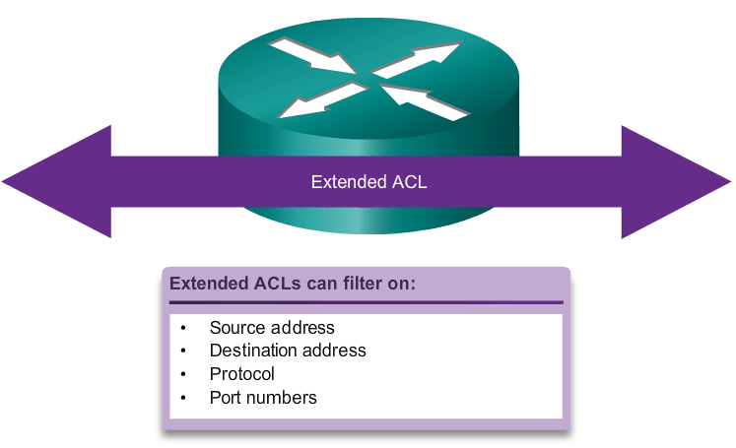
Structure of an Extended IPv4 ACL Extended ACLs
Notes:
9.3.1.1 Extended ACLs

Slide 28
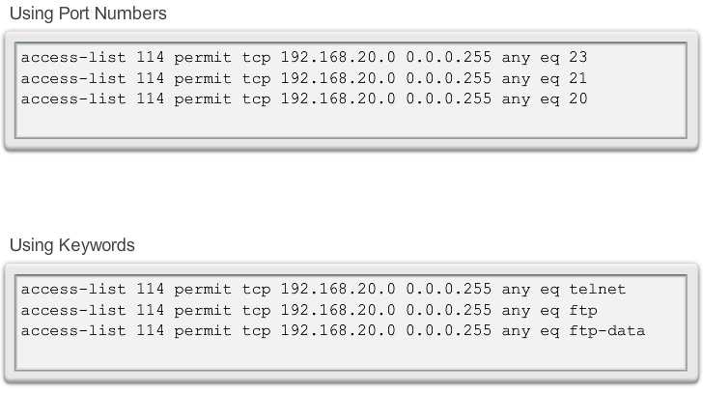
Structure of an Extended IPv4 ACL Extended ACLs (Cont.)
Notes:
9.3.1.2 Extended ACLs (Cont.)

Slide 29
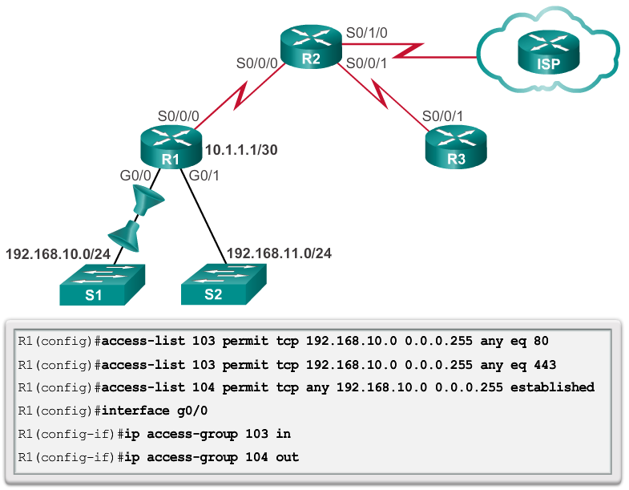
Configure Extended IPv4 ACLs Applying Extended ACLs to Interfaces
Notes:
9.3.2.2 Applying Extended ACLs to Interfaces

Slide 30
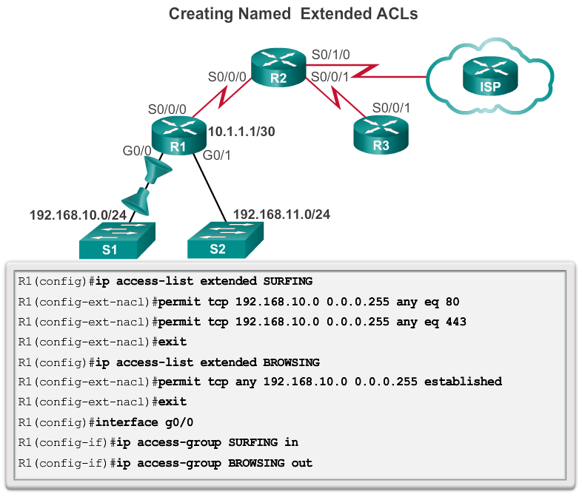
Configure Extended IPv4 ACLs Creating Named Extended ACLs
Notes:
9.3.2.4 Creating Named Extended ACLs

Slide 31
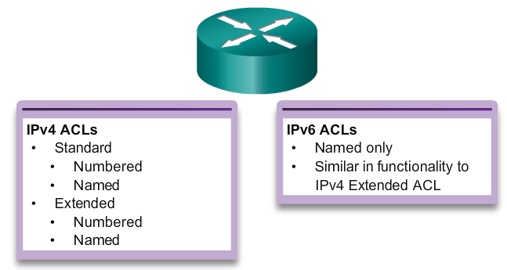
IPv6 ACL Creation Type of IPv6 ACLs
Notes:
9.5.1.1 Type of IPv6 ACLs

Slide 32
IPv6 ACL Creation Comparing IPv4 and IPv6 ACLs
Although IPv4 and IPv6 ACLs are very similar, there are three significant differences between them.
Applying an IPv6 ACL
IPv6 uses the ipv6 traffic-filter command to perform the same function for IPv6 interfaces.
No Wildcard Masks
The prefix-length is used to indicate how much of an IPv6 source or destination address should be matched.
Additional Default Statements
permit icmp any any nd-na
permit icmp any any nd-ns
Notes:
9.5.1.2 Comparing IPv4 and IPv6 ACLs

Slide 33
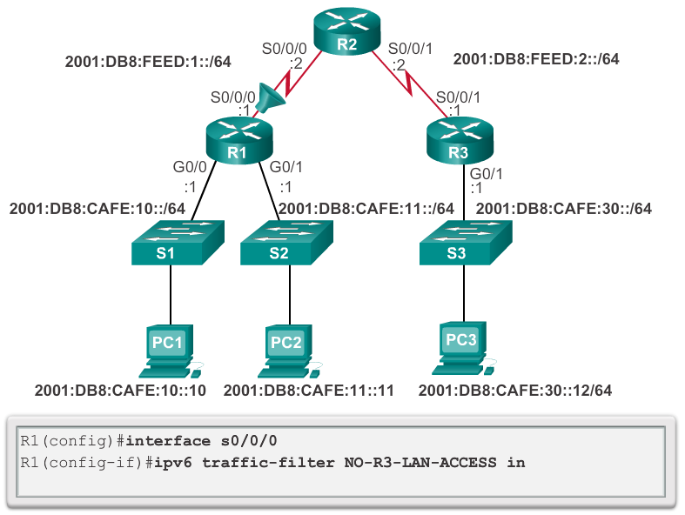
Configuring IPv6 ACLs Applying an IPv6 ACL to an Interface
Notes:
9.5.2.3 Applying an IPv6 ACL to an Interface

Slide 34


